Slide 1


Interrupted Time Series (ITS) in brief
June 2025
Achangwa Chiara, M.Sc., Ph.D.
ciaraacha@gmail.com
Department of Preventive Medicine,
The Catholic University of Korea, Seoul, Korea.

Slide 2
Lecture content
1. Overview of ITS analysis
2. Practice of ITS in R
3. Practical scenario-based practice
Requirements
- A laptop
- R/RStudio installed
- Download the mock data and R code provided

Slide 3
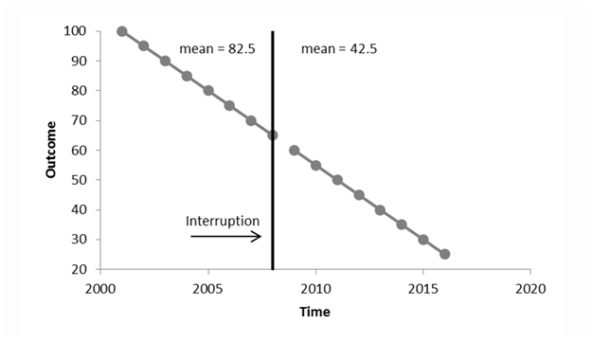
1. Overview of Interrupted Time Series Analysis
Analysis of time series data (i.e., an outcome measured over time)
Comparison before and after an intervention or interruption
Particularly useful for assessing the impact of policy or some other healthcare initiative (pre- to post-comparison)

Slide 4
ITS Analysis
Examples:
1-Changes in the daily number of COVID-19 cases after the implementation of PHSM and vaccination
2- Changes in the number of live births after the implementation of the child encouragement policies
Can we say that the implementation of PHSM and vaccination/child encouragement policies correlated with a decrease/increase in the number of COVID-19 cases / live births?

Slide 5
ITS Analysis
At the core of this analysis is the concept of a counterfactual.
We will be doing some modelling to estimate what did happen (the factual scenario) and what we expect would have happened (the counterfactual scenario) if we had never implemented the policies.
Generally, how the observation changes in response to the Intervention, but there are different kinds of change that we might expect.

Slide 6
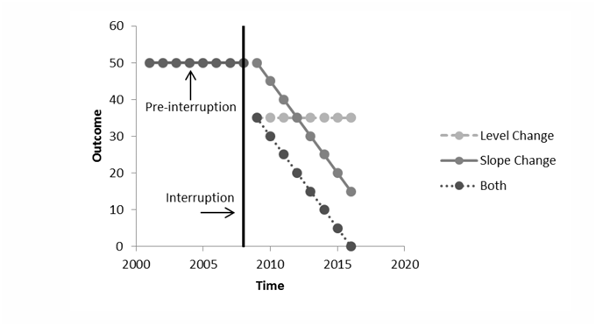
ITS Analysis
The change could take two forms, including;
A level/step change immediately after the intervention
A slope/trend change after the intervention
Both
Are there significant changes in level and/or slope following the intervention?

Slide 7
Types of ITS analysis
Three main types of ITS;
Uncontrolled ITS, one intervention
e.g Evaluate the effect of nationwide COVID-19 lockdown (implemented in March 2020) on the incidence of influenza.
Uncontrolled ITS, two interventions
e.g To evaluate how two national interventions (1993-family planning policy, 2004 – childbirth promoting activities) affected the number of births in Korea between 1975 and 2022.
Controlled ITS, one intervention
e.g Evaluating the Impact of a Smoking Ban on Hospital Admissions for Asthma

Slide 8
ITS model equations
Factual
gls(quantity.x ~ Time + Intervention + Post.intervention.time, data = data, method=“ML”)
Counterfactual
gls(quantity.x ~ Time, data = data, method=“ML”)

Slide 9

Practice session using R!

Slide 10
The Data
Download the mock data sets from the link below: https://github.com/ACHANGWA/Time-series-analysis-lecture
Datasets to be used
mockdataITS - Weekly number of influenza cases
mockdatascenario - Yearly fertility rate in Korea

Slide 11
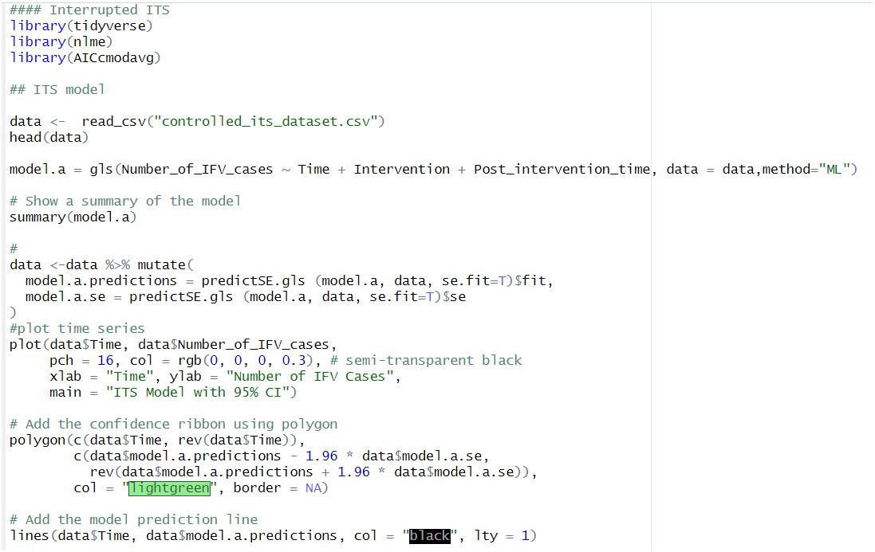
Practice: ITS analysis in R
1. The factual model

Slide 12
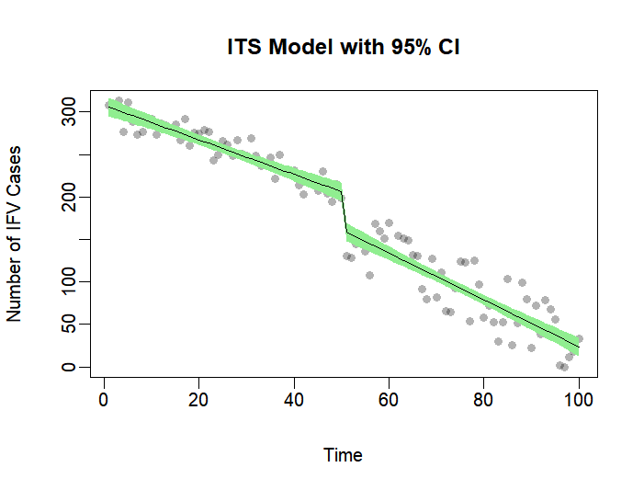
Output

Slide 13
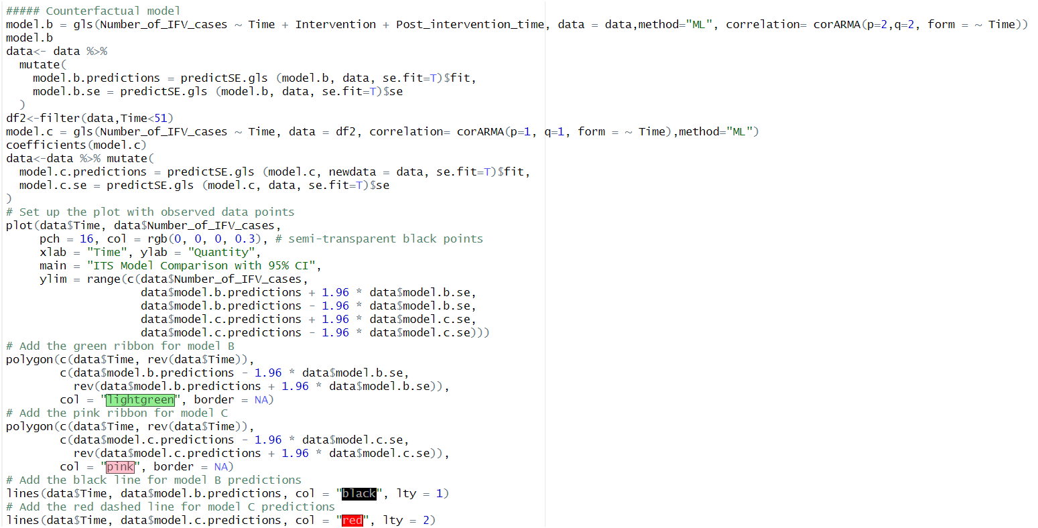
2. The counterfactual model

Slide 14
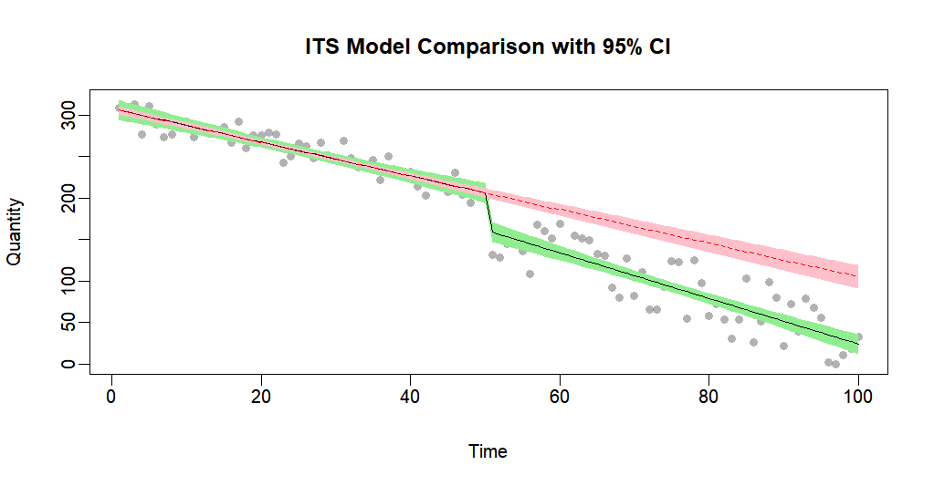
Output

Slide 15
Scenario
The total fertility rate (TFR) in South Korea has shown a continuous decline from 1975 to 2022. Between 1975 and 1992, the government actively promoted a family planning policy, which was discontinued in 1993. Later, in 2004, a birth encouragement policy was introduced to address declining fertility.
Using the provided mock dataset (mockdatascenario), create an Interrupted Time Series (ITS) plot in R to identify changes in the level and trend of TFR associated with these two policy interventions.

Slide 16
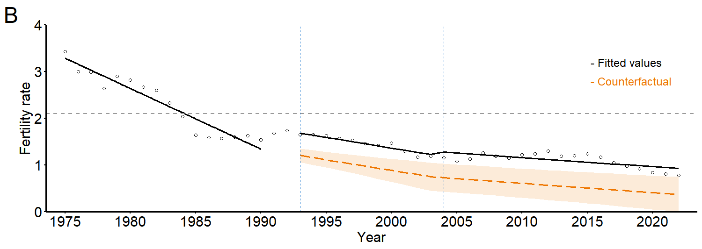
Achangwa et al., JMIR Public Health and Surveillance, 2025.

Slide 17

Thank you!!!
http://onehealth.or.kr/

